Slide 1
New restaurant in Toronto
to choose the right location by providing data about the income and population of each neighbourhood and the competitors who are already present on the same regions.

Slide 2
Restaurant type in Toronto
There’s a lot of different restaurants in Toronto
Maybe different in each area
Analyze cluster, income and population can help stake holders decide on location.

Slide 3
Data acquisition and cleaning
Toronto's 2016 Census contains Population, Average income per Neighbourhood with Toronto’s Neighbourhoods shapefile and Foursquare API. Use this to collect competitors on the same neighbourhoods.
Toronto's Census data is publicly available at this website: https://www.toronto.ca/city-government/data-research-maps/open-data/open-data-catalogue/#8c732154-5012-9afe-d0cd-ba3ffc813d5a
Toronto Neighbourhoods’ shapefile is publicly available at this website: https://www.toronto.ca/city-government/data-research-maps/open-data/open-data-catalogue/#a45bd45a-ede8-730e-1abc-93105b2c439f

Slide 4
Maps to illustrate main findings

Slide 5
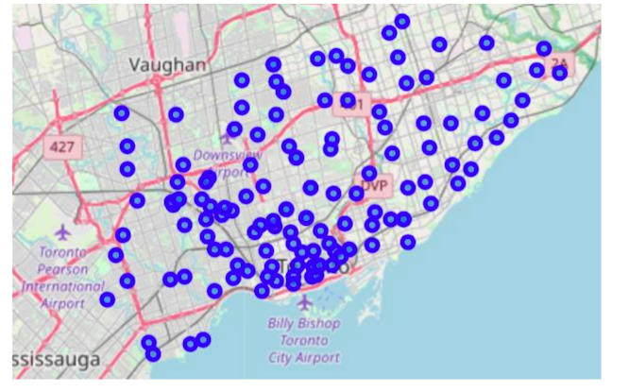
Distribution of neighborhoods for geocoding process

Slide 6
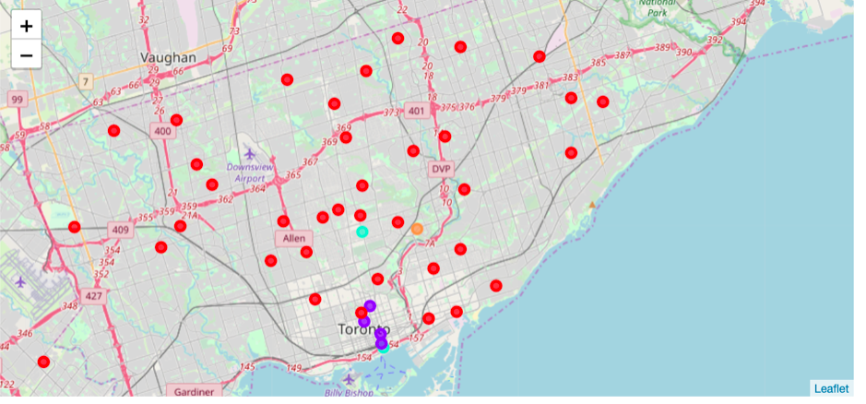
Clustering restaurants in Toronto by k-means

Slide 7
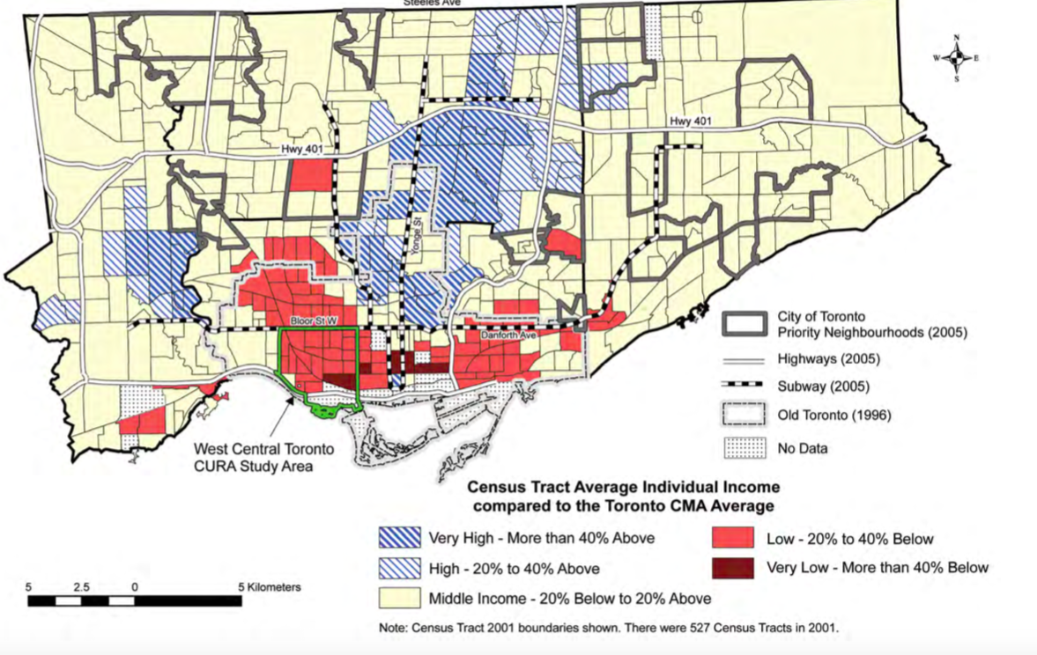
Average Income

Slide 8
Findings
Comparing the maps we can notice many of the restaurants grouped on main streets and on the south of the city, although some of the wealthiest neighbourhood’s are up to the north. Also, the areas with a dense population don't reflect on the number of restaurants.
Learnt that expected to find clusters of restaurants in certain regions and the result didn't meet that expectation.

Slide 9
Conclusions
This report may be helpful for someone planning on opening a restaurant in Toronto, by comparing the current offers and neighbourhood’s profiles, however it may not cover all variables such as access to public transportation or even the restaurants profiles, so it shall not be used as a single deciding making tool.

